Slide 1
‘Rainsavers’: engaging households in Chippenham on rainwater management via water efficiency services
May-Aug 2023
Aimee Shaw, Head of Customer Insight and Participation

Slide 2
Rainsavers project in Chippenham
Overview:
Wessex Water led customer engagement between May and Aug 2023; aimed to engage with 200 households within 8 weeks.
We used our existing free Home Check water saving visits as the vehicle (and part of the customer incentive) to also install free water butts and soaker hoses (where possible) to drain down the water butts into garden borders thus keeping the rainwater out of the sewer.
As per our usual water efficiency targeting, outbound telephone calls were made to customers to offer the service. During the home visits technicians explained how separating rainwater from sewers can be helpful in reducing the operation of storm overflows.
Key outputs/findings:
Over 6,000 outbound calls were made to households in the Chippenham area leading to conversations with over 2,600 customers. From this, 504 customers took up the offer of Homecheck +Rainsaver visit (including a handful that arose from word-of-mouth recommendation). At the first visit, which comprised the water efficiency Home Check service and a water butt suitability assessment, 295 properties went on to have water butts installed. Only 11% of these were suitable for a soaker hose meaning the majority of installations had limited impact on diverting rainfall from sewers.
Of the customers that turned down the Rainsavers visits: 57% simply had no interest, 24% stated they already had a water butt, 16% said they had no space for a water butt and 3% said they would prefer to just have the standard Home Check visit.
Of the properties that were surveyed for a water butt installation but were not suitable: the majority (89%) did not have a suitable downpipe; other reasons were the customer changed their mind, not enough space or no hardstanding near the downpipe.
Soaker hose installations were limited typically due to the siting of the water butt and the need to cross patios and paths which could cause a trip hazard. Where possible the plumbers worked around this, such as snaking around the exterior of the property with impermeable hose. More intrusive adaptations such as the installation of French drains/ducting to move rainwater beneath pathways may help, but would come at additional cost, and inconvenience to the customer.

Slide 3
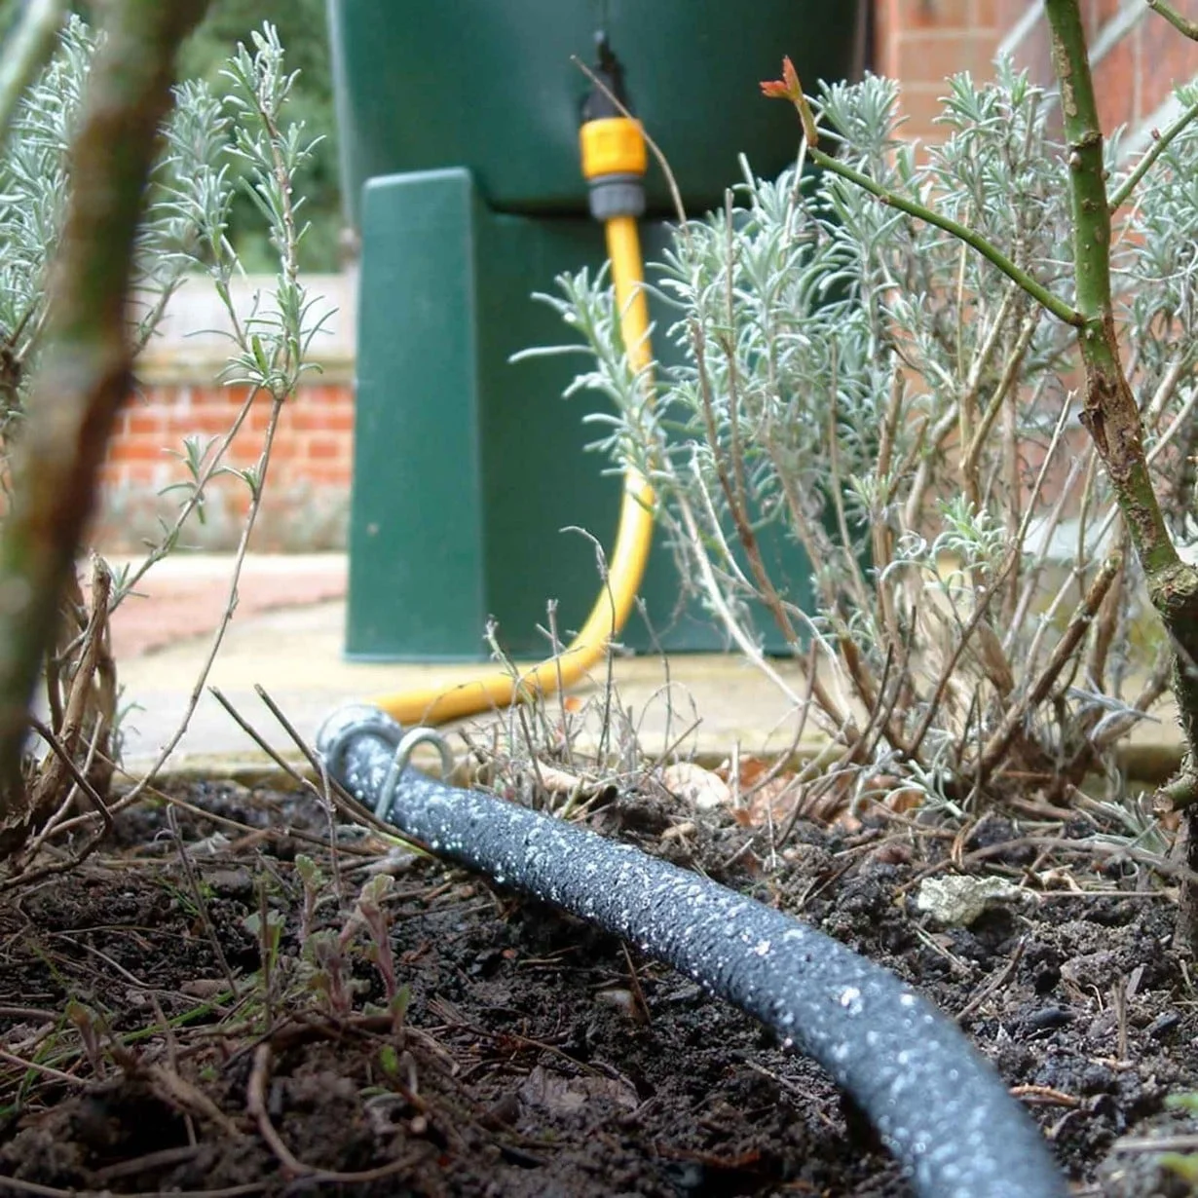
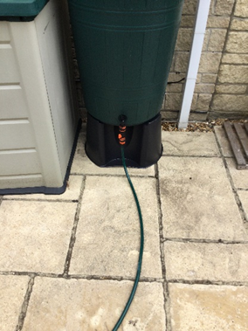
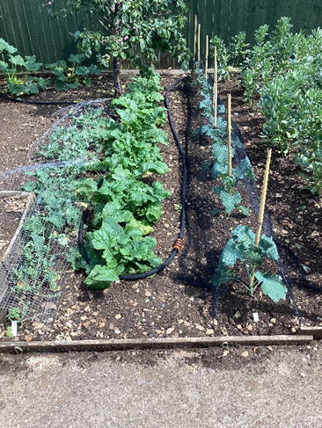
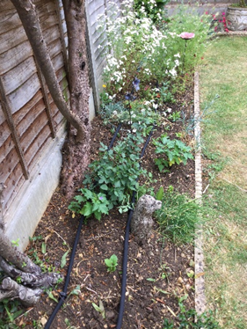
Rainsavers project in Chippenham
Installations in Chippenham
www.harrodhorticultural.com
Notwithstanding that this was a trial in only one geographical town and of only modest scale, the evidence suggests it would not be recommended to include soaker hoses in our future rainwater management strategy, unless perhaps in combination with other interventions.
Customers were very positive about the Home Check +Rainsavers visits. In a post-visit survey of 52 customers, 98.5% gave a feedback rating of 10 out of 10. This was generally paired with praise for the programme and a perception that Wessex Water was being proactive in supporting customers with both water efficiency and reducing rainwater into sewers.
Customer appetite for the more intrusive option of installing soakaways or rainwater gardens was split (if free to customer): 49% were interested, 10% would need more information and 41% were a definite no (typically expressing concerns about disruption or alteration of their garden).
Prior to the project, most customers understood the water efficiency benefits of collecting rainwater. The project increased most customers’ understanding of how the management of rainwater falling on their homes can links to the operation of storm overflows.

Slide 4
Rainsavers: Other useful information
286 x 200 litre water butts were installed by the projects = 57,200 litres of storage.
Technicians estimated roof area being connected to the water butts at each property. The average roof area was 35.2m². (Water butts were typically only installed in the rear garden, meaning this was ~half overall roof per property)
Average rainfall in the Wessex Water region is 920mm a year meaning an average total roof area of 70.4m² generates 64,768 litres of rainfall to manage per property per year. For all rainwater to be captured and prevented from entering the sewer this would need a single 200 litre water butt to be filled and drained 324 times.
Manual observation of the soaker hose system in action found that an 8m length released a full 200 litre water butt into the ground over 12.5 hours.

